Slide 1



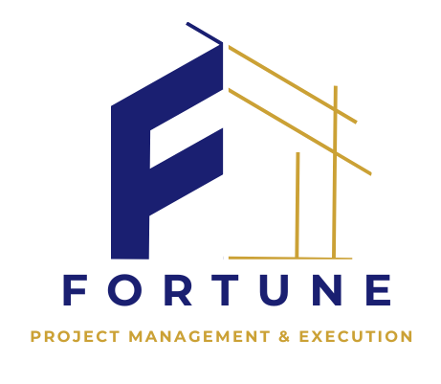
FORTUNE
PROJECT MANAGEMENT & EXECUTION
COMPANY
PROFILE

Slide 2

CEO Statement
At FORTUNE, we believe in more than just delivering projects—we create smart, sustainable solutions that build lasting value. Our strength lies in our ability to adapt, using agile and hybrid methodologies to meet the evolving needs of our clients.
We’re proud to lead with innovation and integrity, backed by a skilled team and a forward-thinking mindset. Through our e-learning platform and professional training programs, we also invest in the future of our industry.
Thank you for being part of our journey. Together, we’re building more than projects—we’re building futures.
Warm regards,
ENG.ABDULAZIZ GASIM
MBA,PMP,PMI-RMP
CEO & Founder

Slide 3
Table of Contents
Objective of This Guide
Prerequisites
2
3
4
5
6
8
9
11
14
17
System Description
Dashboard Walkthrough
Using Core Features
Common Problems and Solutions
Routine Maintenance Guide
Safety Instructions
Key Terms and Definitions
Extra Tools and Resources

Slide 4
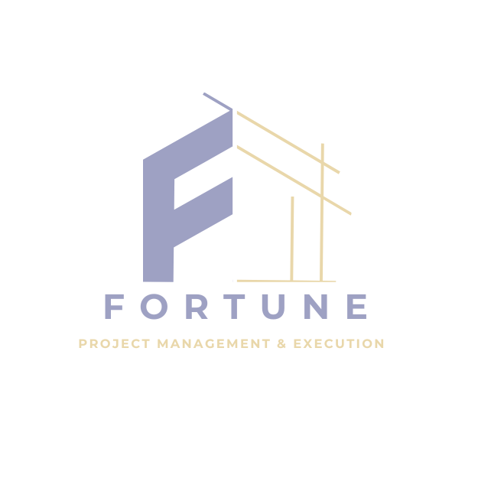
WELCOME …
LEARN
MORE
Welcome to FORTUNE, your trusted partner in project management, execution, and professional development. We specialize in delivering end-to-end project solutions that transform complex ideas into successful, results-driven outcomes. From strategic planning to flawless execution, our experienced team ensures every project is completed on time, within scope, and to the highest standards of quality.
In addition to our core services, FORTUNE is proud to offer a cutting-edge e-learning platform dedicated to empowering the next generation of project leaders.
Our platform provides a wide range of professional certifications in business and project management. These programs combine expert-led instruction with interactive, flexible learning—equipping professionals with the knowledge, practical skills, and globally recognized credentials needed to thrive in today’s dynamic environments.
At FORTUNE, we don’t just manage projects—we build futures.
Excellence, Accountability, Innovation, Sustainability

Slide 5
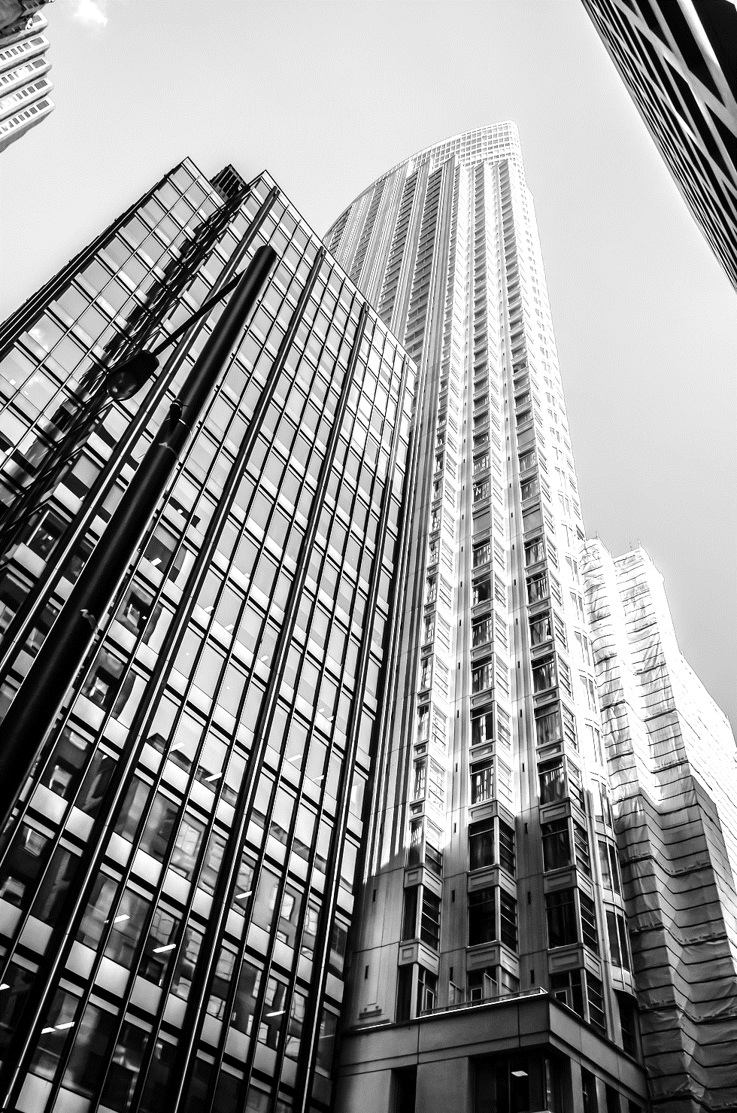
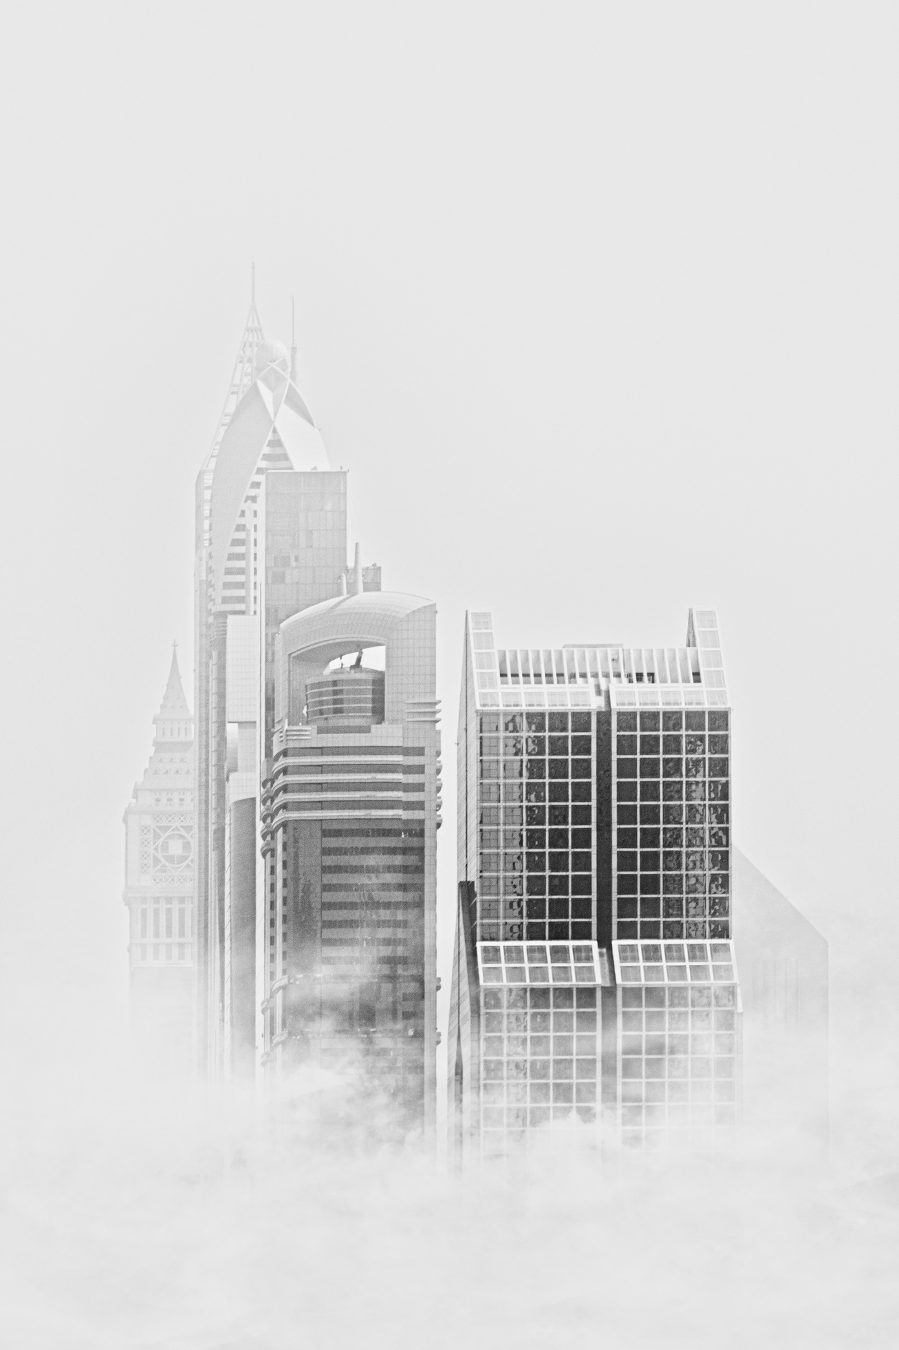
FORTUNE
VISION & MISSION
Aspiration
Our vision is to redefine the future of construction by delivering intelligent, value-driven solutions that exceed client expectations—leveraging innovation, sustainability, and the strategic use of agile and hybrid methodologies, all while upholding our commitment to excellence and accountability.
Smart Solutions. Real Value. Lasting Satisfaction.
Our mission is to lead the construction industry by staying adaptable, combining expert skills with hybrid and agile methods to deliver innovative, efficient, and sustainable solutions that consistently exceed expectations.
Commitment

Slide 6
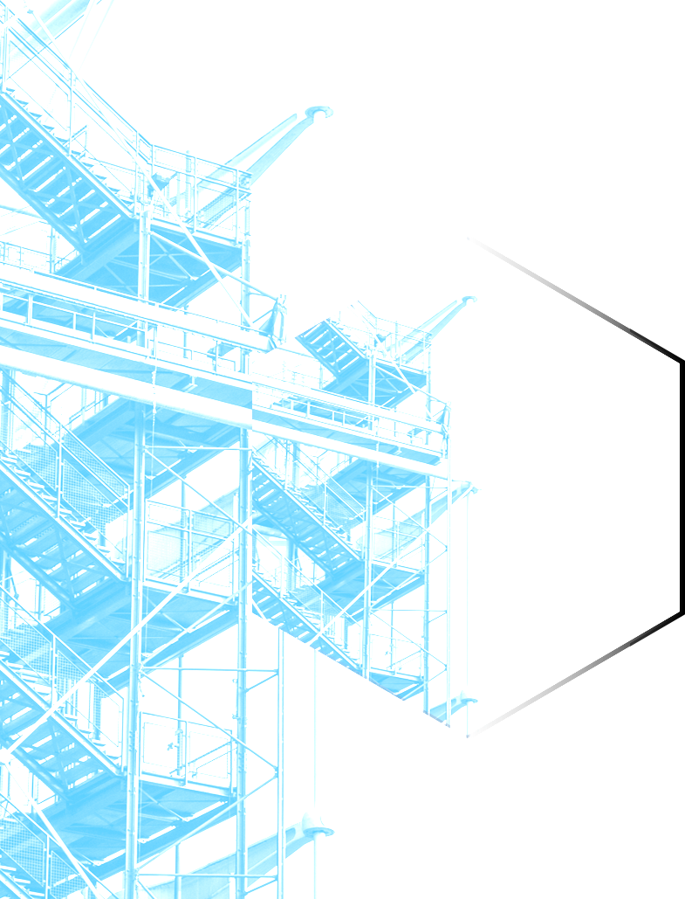
💡 What Sets Us Apart
At FORTUNE, we go beyond traditional project delivery. What makes us different is our ability to combine expertise, innovation, and adaptability to meet the demands of a rapidly changing industry.
Agile & Hybrid Methodologies – We adapt quickly and work smarter, ensuring flexibility and high performance.
Innovation-Driven – We integrate cutting-edge technologies and tools to enhance efficiency and outcomes.
E-Learning Leadership – Our digital training platform empowers professionals with globally recognized certifications.
Sustainability Focus – We prioritize environmentally responsible solutions, especially in renewable energy projects.
Client-Centric Approach – We tailor every solution to exceed client expectations and ensure long-term value.
Skilled, Multidisciplinary Team – Our diverse talent pool brings deep expertise across sectors and technologies.

Slide 7
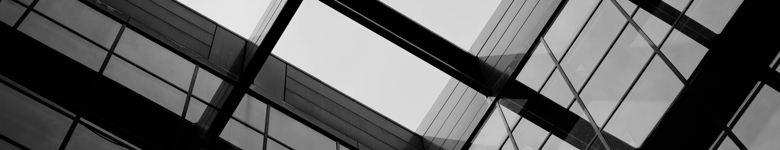

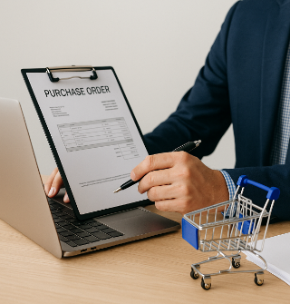
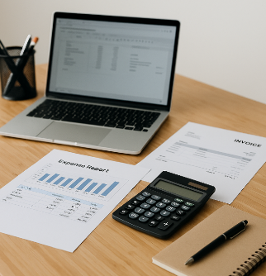
FORTUNE
SERVICE
01
02
03
01
Contracting
Procurement
Cost Management
Civil & Finishes Works
Fit out & Interior Works
Electrical Works
Mechanical & Plumping Works
HVAC Works
IT & Low current Works
Fire Fighting Works
Managing sourcing activities,
evaluating suppliers,
securing competitive prices,
ensuring timely delivery of materials and services.
Developing budgets,
monitoring expenditures,
forecasting financial performance,
maintaining full cost control throughout the project lifecycle.

Slide 8
FORTUNE
SERVICE
04
05
06
01
Contract & Claims Management
Procurement
Cost Management
Ensuring effective contract administration
Tracking variations, preparing claims, and protecting client rights through clear documentation and compliance.
Managing sourcing activities,
evaluating suppliers,
securing competitive prices,
ensuring timely delivery of materials and services.
Developing budgets,
monitoring expenditures,
forecasting financial performance,
maintaining full cost control throughout the project lifecycle.

Slide 9
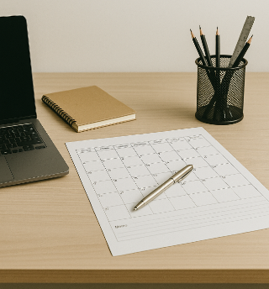
FORTUNE
SERVICE
07
08
Planning management
Learning & Professional Training
Building detailed project schedules, setting milestones
allocating resources efficiently, monitoring progress to achieve timely project delivery.
PMP® Certification & Project Management
Business Management & Risk Management
Renewable Energy & Sustainability
Primavera P6 & Microsoft Tools
FIDIC Contracts & Construction Law
Data Analysis & Decision-Making Skills
All courses are aligned with global standards and designed to deliver practical, real-world value.

Slide 10
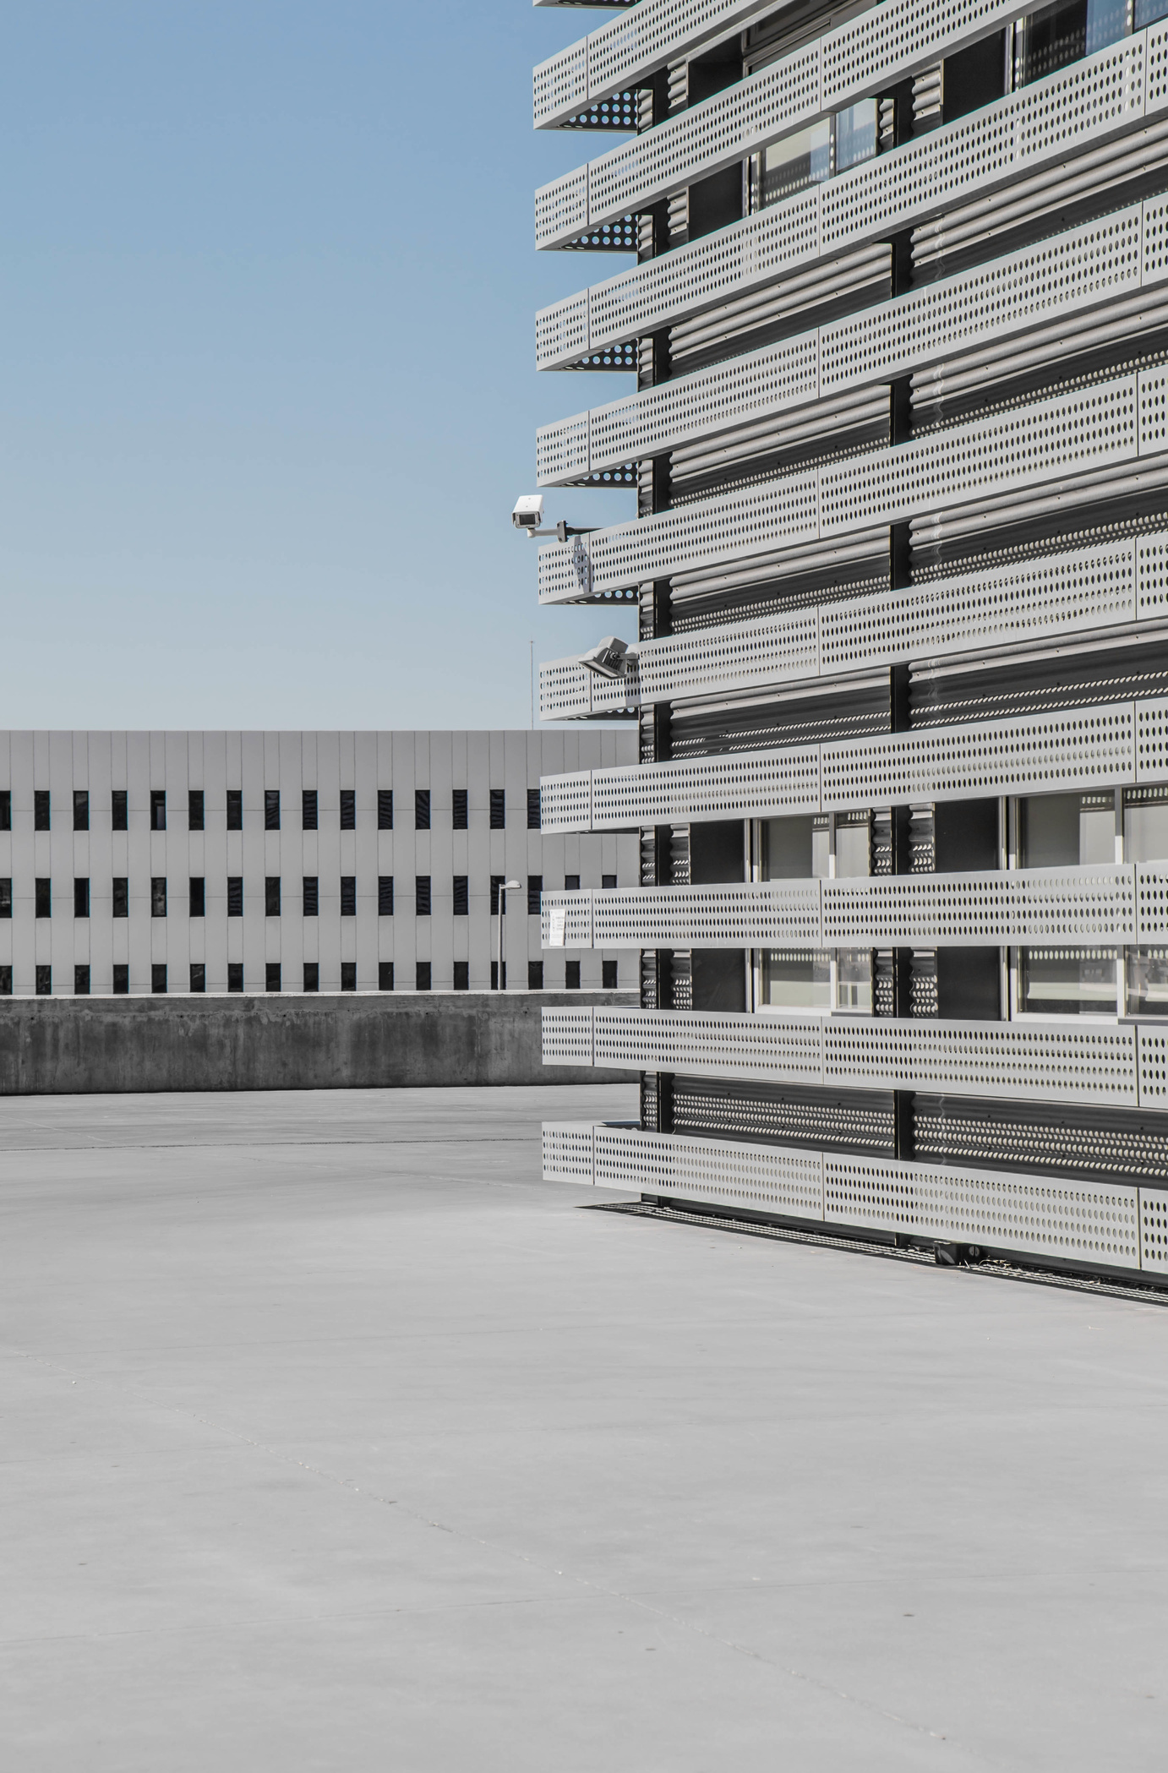
PROJECTS
Construction
ALi OTHAIM TRAIN
REHABILITATION
  ASIA HOSPITAL
UNICEF Premises
Dr.Osman Shareef Villa
Giad Automotive Paint Facility
Alhandsya Ready-Mix Concrete Plant
Construction
  Dr.Khalid Ahmed Multi Story Building
DESIGN REVIEW
  ALRAGHI TILAL TWOERS
www.reallygreatsite.com
10

Slide 11
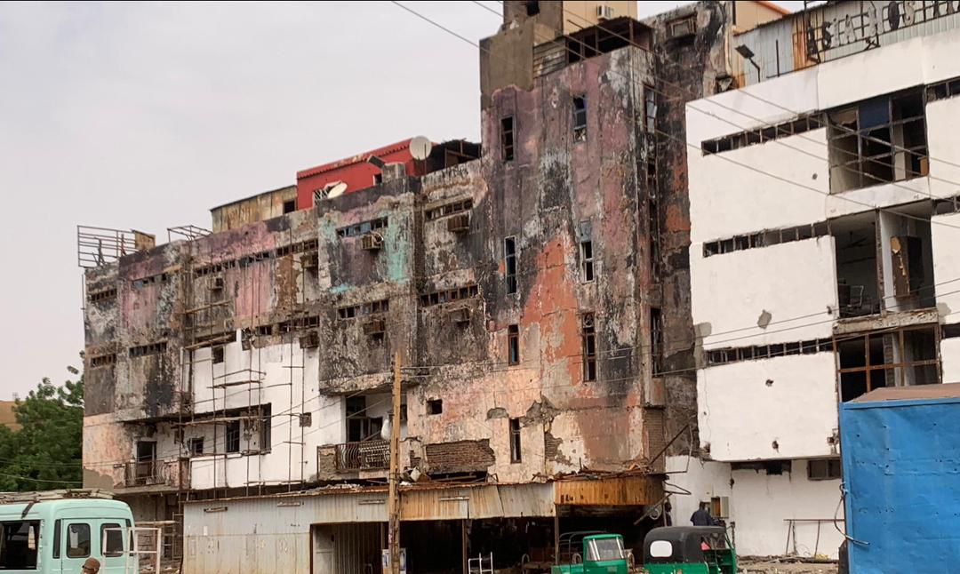
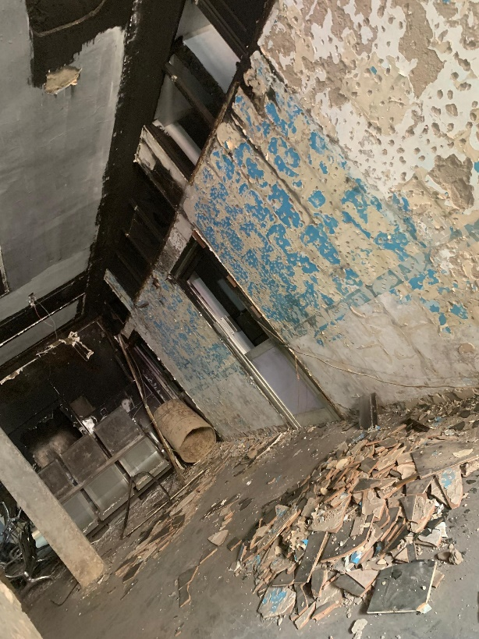
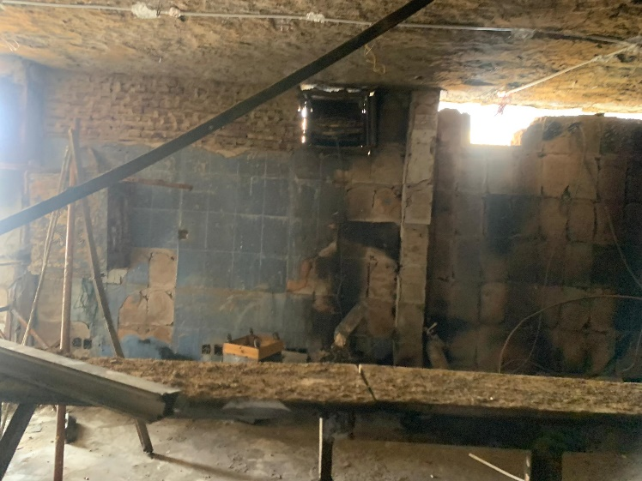
OUR CURRENT PROJECTS
ASIA HOSPITAL REHABILITATION
Client: Mr.Salah Hamza
Location :Khartoum/Omderman
Project Description: Asia Hospital is a medium-sized private healthcare facility located in Omdurman, Khartoum State. The hospital has an estimated built-up area of 4,500 m² and includes emergency services, outpatient clinics, inpatient wards, ICU, operating theatres, diagnostics, pharmacy, administrative offices, and full MEP service areas. The facility requires comprehensive rehabilitation.
01
2
FORTUNE

Slide 12
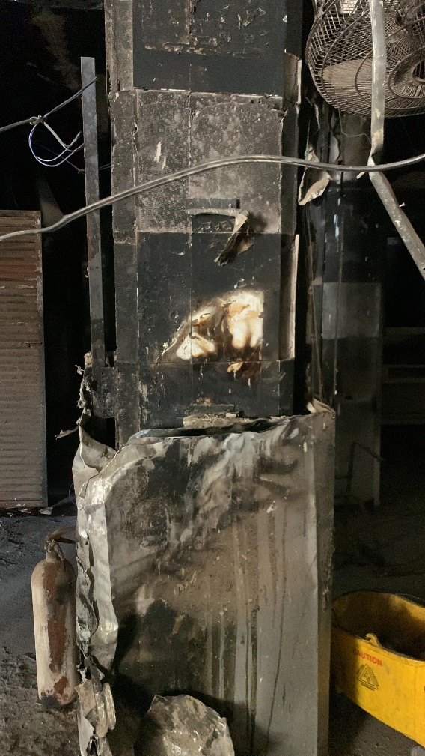
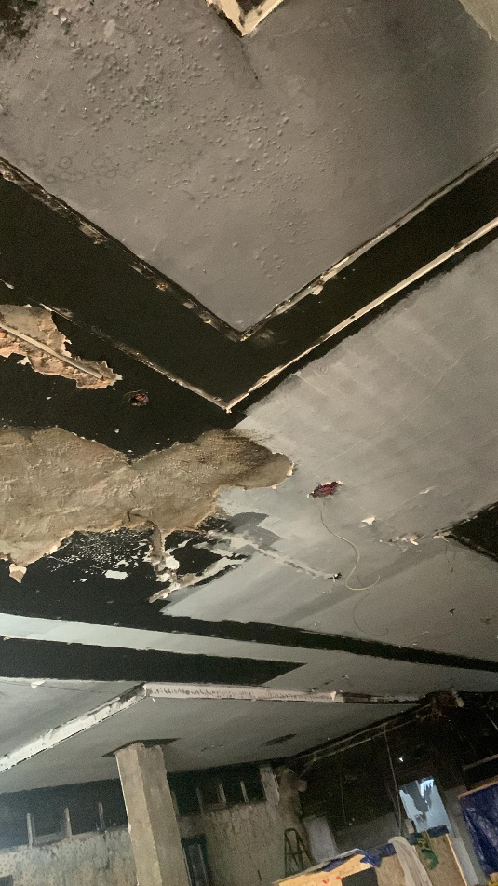
OUR CURRENT PROJECTS
ASIA HOSPITAL REHABILITATION
Fortune Scope of Work: Architectural works: repairs, finishes renewal, waterproofing, layout improvements. Structural works: condition assessment, strengthening, crack and slab/beam/column repairs. Mechanical systems: HVAC servicing, plumbing repairs, pump room rehabilitation, medical gas inspection. Electrical & ELV systems: boards, cabling, lighting, generators, UPS, fire alarm, CCTV. Fire safety systems: pumps, extinguishers, detectors, compliance upgrades. External works: parking, walkways, boundary elements, utilities. Technical documentation: drawings, BOQs, specifications, method statements. Supervision: site monitoring, testing & commissioning, final handover documentation.
02
2
FORTUNE

Slide 13
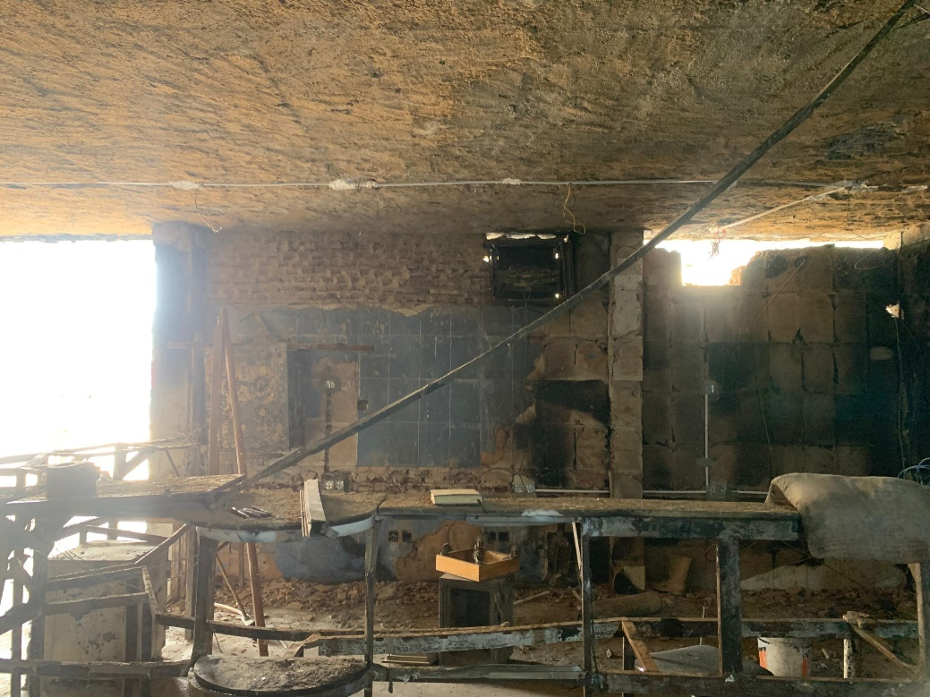
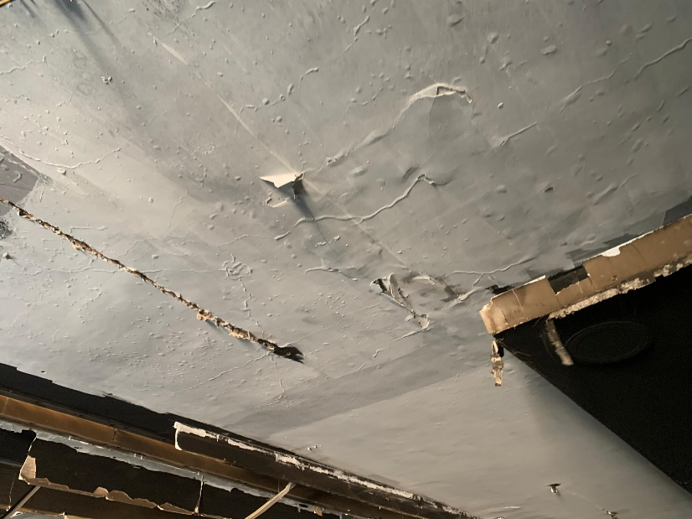
OUR CURRENT PROJECTS
ASIA HOSPITAL REHABILITATION
Fortune Scope of Work:
condition assessment, and comprehensive rehabilitation of Asia Hospital, covering architectural upgrades, structural strengthening, complete MEP systems maintenance (HVAC, plumbing, medical gases, electrical and ELV networks),
fire-safety compliance works, external improvements, and the preparation of all technical documentation and supervision required to ensure safe, functional, and fully operational healthcare facilities.
Project Value: 1,750,000 USD
Status: Ongoing.
03
2
FORTUNE

Slide 14
OUR CURRENT PROJECTS
Dr.Khalid Ahmed Ali/Multi Story Building Phase Two
Client: Dr.Khalid Ahmed Ali
Location :Khartoum/AL Rwabi residential compound/ Soba
Project Description: The building is a mid-rise residential structure consisting of a ground floor and five upper levels, with an approximate built-up area of 1,200 m². The property comprises a total of 11 well-planned apartments designed to optimize functionality, natural lighting, and efficient circulation. The structural system is based on reinforced concrete elements with compliant architectural and MEP provisions, supporting high-quality residential use. The layout includes dedicated vertical circulation (stairs and service shafts), organized apartment floor plans, and essential building services such as electrical distribution, plumbing networks, ventilation systems, and fire-safety provisions. The overall configuration reflects a compact, efficient, and durable residential building suitable for long-term occupancy and maintenance.
04
2
FORTUNE

Slide 15
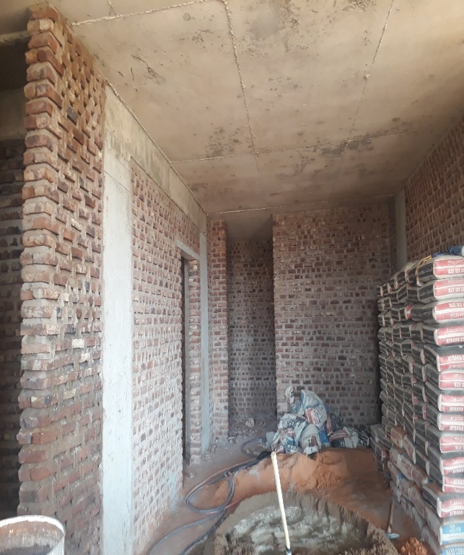
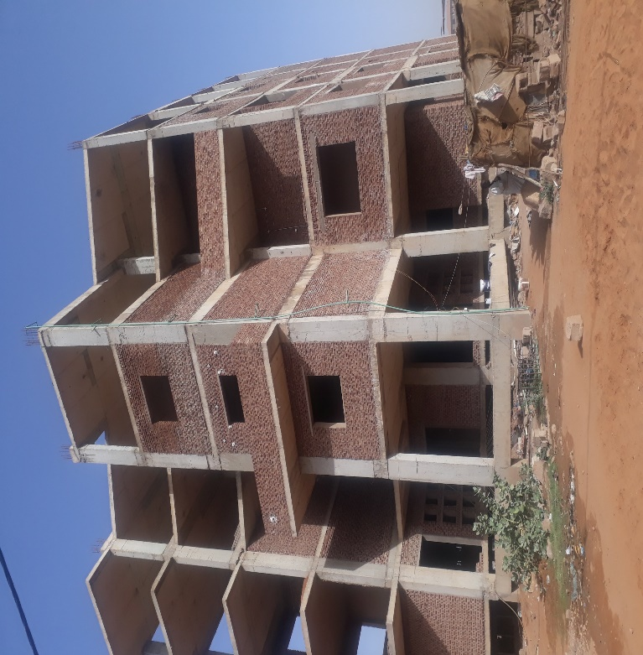
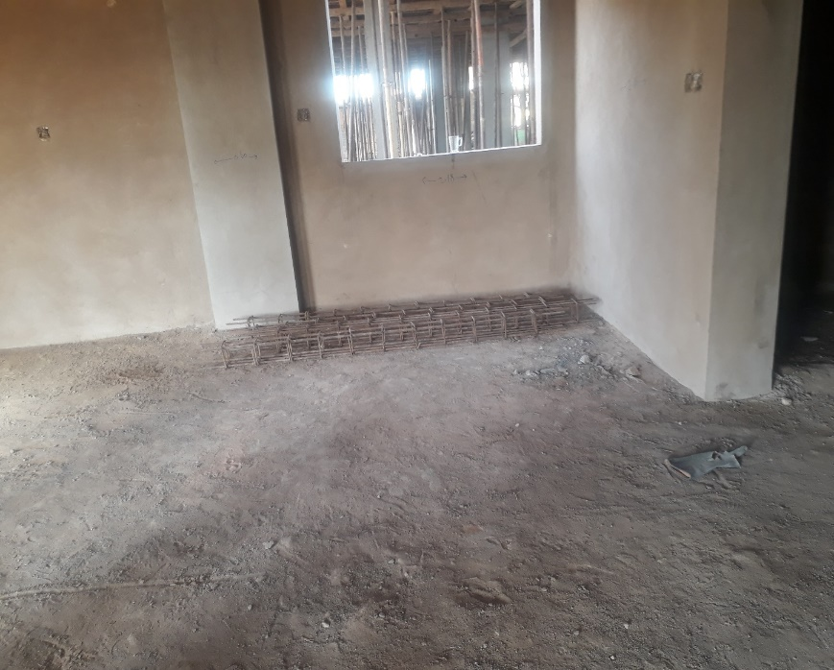
OUR CURRENT PROJECTS
Dr.Khalid Ahmed Ali/Multi Story Building
Fortune Scope of Work : complete finishing works for the residential building, including internal and external architectural finishes, flooring, wall treatments, ceilings, doors and windows installation, sanitary fittings, plumbing fixtures, electrical fixtures and lighting, painting works, façade treatments, stair finishes, and all complementary details required to deliver fully completed, high-quality, and ready-to-occupy residential units in accordance with project specifications and industry standards.
Project Value: 1,750,000 USD
Status: Ongoing.
05
2
FORTUNE

Slide 16
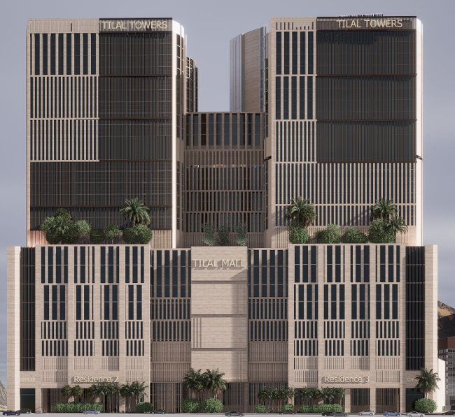
OUR CURRENT PROJECTS
ALRAGHI TILAL TWOERS DESIGN REVIEW Project
Client: TEKNO Consultancy
Location : MAKKA, KSA
Fortune Scope of Work:
As PMC Firm FORTUNE has been working under Tekno Consultancy in Saudi Arabia ,overseeing full project management services. The scope included contract review, cost management, payment tracking and preparation, project planning and scheduling, monitoring and reporting, claims and variation orders management, as well as BOQ development, pricing, and overall cost control.
Project Value: 480,000 SAR
Status: Ongoing.
06
2
FORTUNE

Slide 17
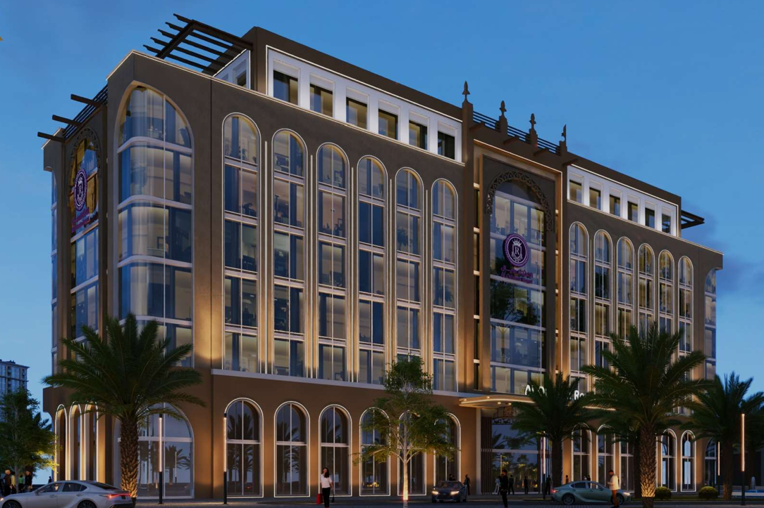
OUR CURRENT PROJECTS
AL OTHAIM TRAIN Construction Project
Client: TEKNO Consultancy – Main Consultant
Location : AL HASSA, KSA
Fortune Scope of Work:
As PMC Firm FORTUNE has been working under Tekno Consultancy in Saudi Arabia ,overseeing full project management services. The scope included contract review, cost management, payment tracking and preparation, project planning and scheduling, monitoring and reporting, claims and variation orders management, as well as BOQ development, pricing, and overall cost control.
Project Value: 800,000 SAR
Status: Ongoing.
07
2
FORTUNE

Slide 18
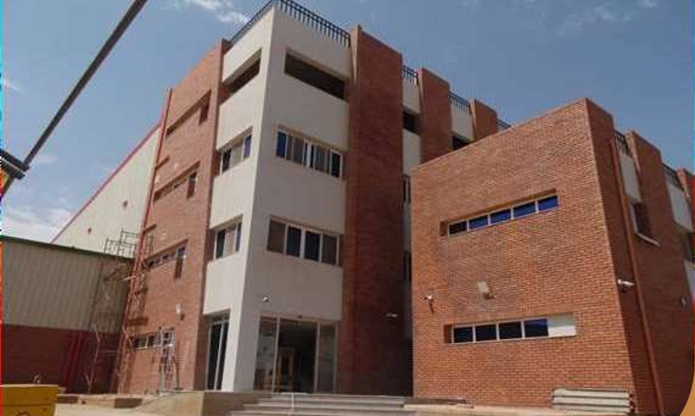
OUR EXECUTED PROJECTS
AGRO Power Toothpaste Factory Project
Client: Sudabuild Co- Main Contractor
Location : Khartoum, Sudan
Project Description:
FORTUNE Scope of Work: As a PMC to Sudabuild, Fortune was responsible of drafting & developing the project contract services for the project. This including drafting terms, defining responsibilities, coordinating with stakeholders, monitoring compliance, managing variations and payments, and ensuring the project is executed in accordance with contractual, technical, and commercial requirements.
Project Value: 2,160,000 USD
Status: Completed June 2021.
8
FORTUNE

Slide 19
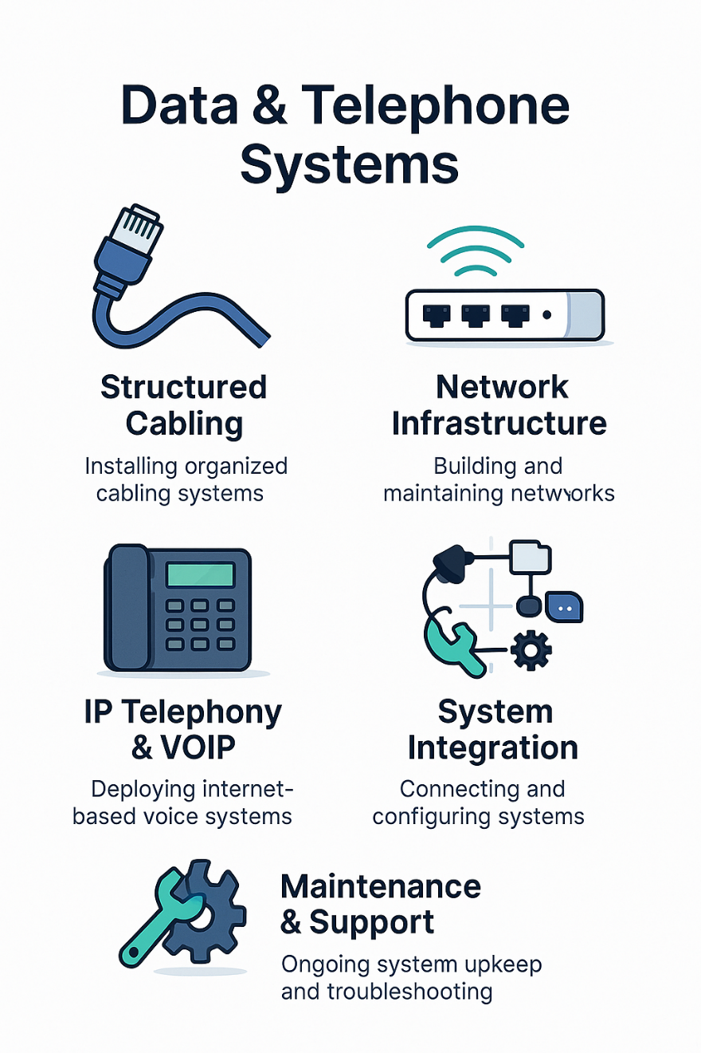
OUR EXECUTED PROJECTS
ASIA HOSPITAL IT, Data & Telephone Project
Client: Mr.Salah Hamza
Location :Khartoum/Omderman
FORTUNE Scope of Work:
As a Managerial Partner with FASETEC Company FORTUNE was responsible of:
Data, Telephone & IT Systems: Complete installation and commissioning of structured cabling, telephone networks, and IT infrastructure using advanced, hospital-grade technologies.
CCTV & Security Systems: Deployment of high-resolution CCTV with remote monitoring and centralized control for seamless supervision and enhanced security.
Project Value: 18,000 USD
Status: Completed Nov 2025.
13
2
FORTUNE

Slide 20
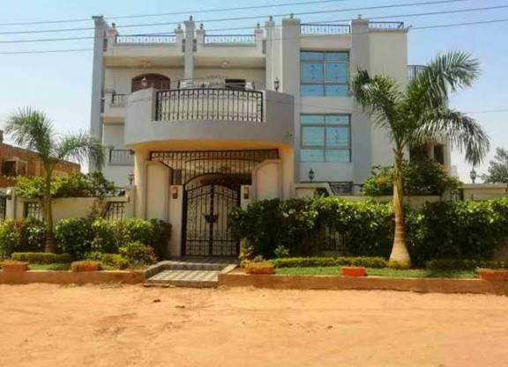
OUR EXECUTED PROJECTS
Dr.Osman Shareef Villa/Former President of The Sudanese Bar Association
Client: Dr.Osman Shareef
Location :Khartoum /Amarat St 51
FORTUNE Scope of Work:
The project involves the comprehensive renovation of a three-storey private villa with an adjoining landscaped garden. The scope includes upgrading architectural finishes, modernizing building services, enhancing structural integrity where required, and improving external works to deliver a fully renewed, functional, and aesthetically upgraded residential property.
Project Value : 123,000 USD
Status: Completed Nov 2025.
15
2
FORTUNE

Slide 21
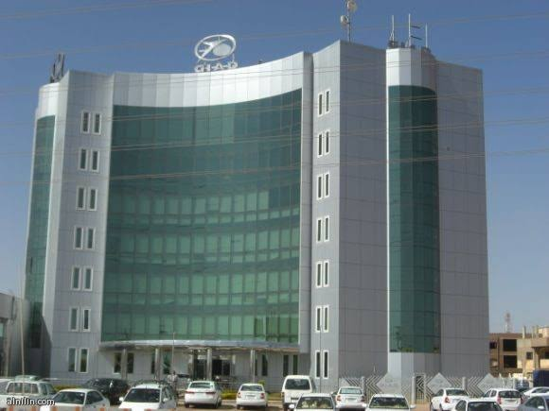
OUR EXECUTED PROJECTS
Giad Automotive Paint Facility
Client: Alhadari Company-Main Contractor
FORTUNE Scope of Work:
As a subcontractor to Alhadari Company, Fortune was responsible for the rehabilitation of the Giad Automotive Paint Facility, including the refurbishment of the main steel hangar structure, renewal of external works, and complete upgrading of service areas and sanitary facilities. The scope focuses on restoring operational efficiency, improving safety and environmental performance, and delivering a fully functional, modernized paint production environment that meets industrial standards.
Project Value : 90,000 USD
Status: Completed Nov 2025.
03
2
FORTUNE

Slide 22
OUR EXECUTED PROJECTS
Saura Al-Bagair Industrial Facility
Client: Alhadari Company-Main Contractor
FORTUNE Scope of Work: As a subcontractor to Alhadari Company, Fortune was responsible for the the comprehensive rehabilitation of the Saura Al-Bagair Industrial Facility, including structural upgrades, renewal of architectural finishes, modernization of mechanical and electrical systems, and improvement of external infrastructure. The works aim to restore full operational capacity, enhance safety and production efficiency, and deliver a modernized facility that meets current industrial performance and compliance standards.
Project Value : 55,000 USD
Status: Completed Nov 2025.
16
2
FORTUNE

Slide 23
OUR EXECUTED PROJECTS
Mr.Mohammed Alameen Alsheck House
Client: Alhadari Company-Main Contractor
Location: Khartoum /Andalos
FORTUNE Scope of Work:
As a subcontractor to Alhadari Company, Fortune was responsible for the construction of a two–storey residential villa, including full architectural works, reinforced concrete structural elements, complete MEP installations (electrical, plumbing, HVAC), internal and external finishes, façade treatments, boundary walls, landscaping, and site utilities. The house is designed to provide functional family living spaces, optimized natural lighting, efficient circulation, and high-quality materials that meet modern residential standards from foundation to final handover.
Project Value : 50,000 USD
Status: Completed Nov 2025.
17
2
FORTUNE

Slide 24
OUR EXECUTED PROJECTS
Mr.Imad Awad Alkareem House
Location: Khartoum /Omderman/Althawra
Client: Alhadari Company-Main Contractor
FORTUNE Scope of Work: As a subcontractor to Alhadari Company, Fortune was responsible for the construction of a two-storey residential house using a load-bearing wall structural system. The works include site preparation, masonry foundation construction, erection of structural load-bearing walls, installation of reinforced concrete slabs, and completion of all architectural finishes for both floors.
Project Value : 30,000 USD
Status: Completed Nov 2025.
18
2
FORTUNE

Slide 25
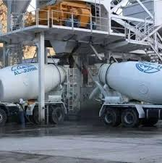
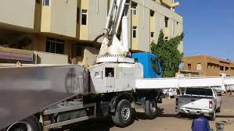
OUR EXECUTED PROJECTS
Alhandsya Ready-Mix Concrete Plant Rehabilitation
Client: Alhadari Company-Main Contractor
FORTUNE Scope of Work: As a subcontractor to Alhadari Company, Fortune was responsible for the rehabilitation and functional upgrade of Alhandsya Ready-Mix Concrete Plant, including the construction of a new washing bay, a vehicle lubrication and maintenance area, worker rest facilities, a fully equipped concrete testing laboratory, and new sanitary units. The works aim to enhance operational efficiency, improve service workflows, and provide compliant support facilities that meet industrial safety and quality standards.
Project Value : 33,000 USD
Status: Completed Nov 2025.
19
2
FORTUNE

Slide 26




Construction
ALi OTHAIM TRAIN
REHABILITATION
  ASIA HOSPITAL
UNICEF Premises
Dr.Osman Shareef Villa
Giad Automotive Paint Facility
Alhandsya Ready-Mix Concrete Plant
Construction
  Dr.Khalid Ahmed Multi Story Building
DESIGN REVIEW
  ALRAGHI TILAL TWOERS
E-Learning Platform
Selfelearn delivers accessible, expert-led online training in Project Management, PMP, AI & Data Analysis, HR, Business, and Engineering fields. The platform empowers professionals through flexible, on-demand learning and practical skill-building programs.
Through Selfelearn, Fortune PMX strengthens client capacity, offering continuous support in training, development, and team competency enhancement, ensuring our partners always stay ahead in knowledge and performance.
www.selfelearn.com
@Selfelearn
@Selfelearn

Slide 27
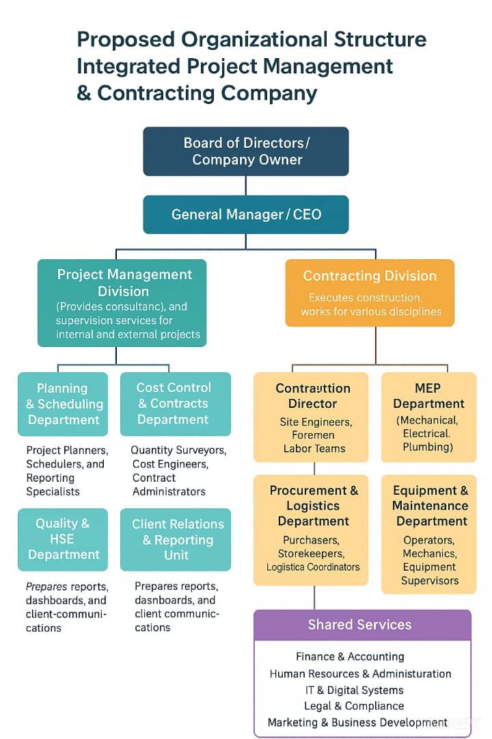
Construction
ALi OTHAIM TRAIN
REHABILITATION
  ASIA HOSPITAL
UNICEF Premises
Dr.Osman Shareef Villa
Giad Automotive Paint Facility
Alhandsya Ready-Mix Concrete Plant
Construction
  Dr.Khalid Ahmed Multi Story Building
DESIGN REVIEW
  ALRAGHI TILAL TWOERS
Organizational chart

Slide 28
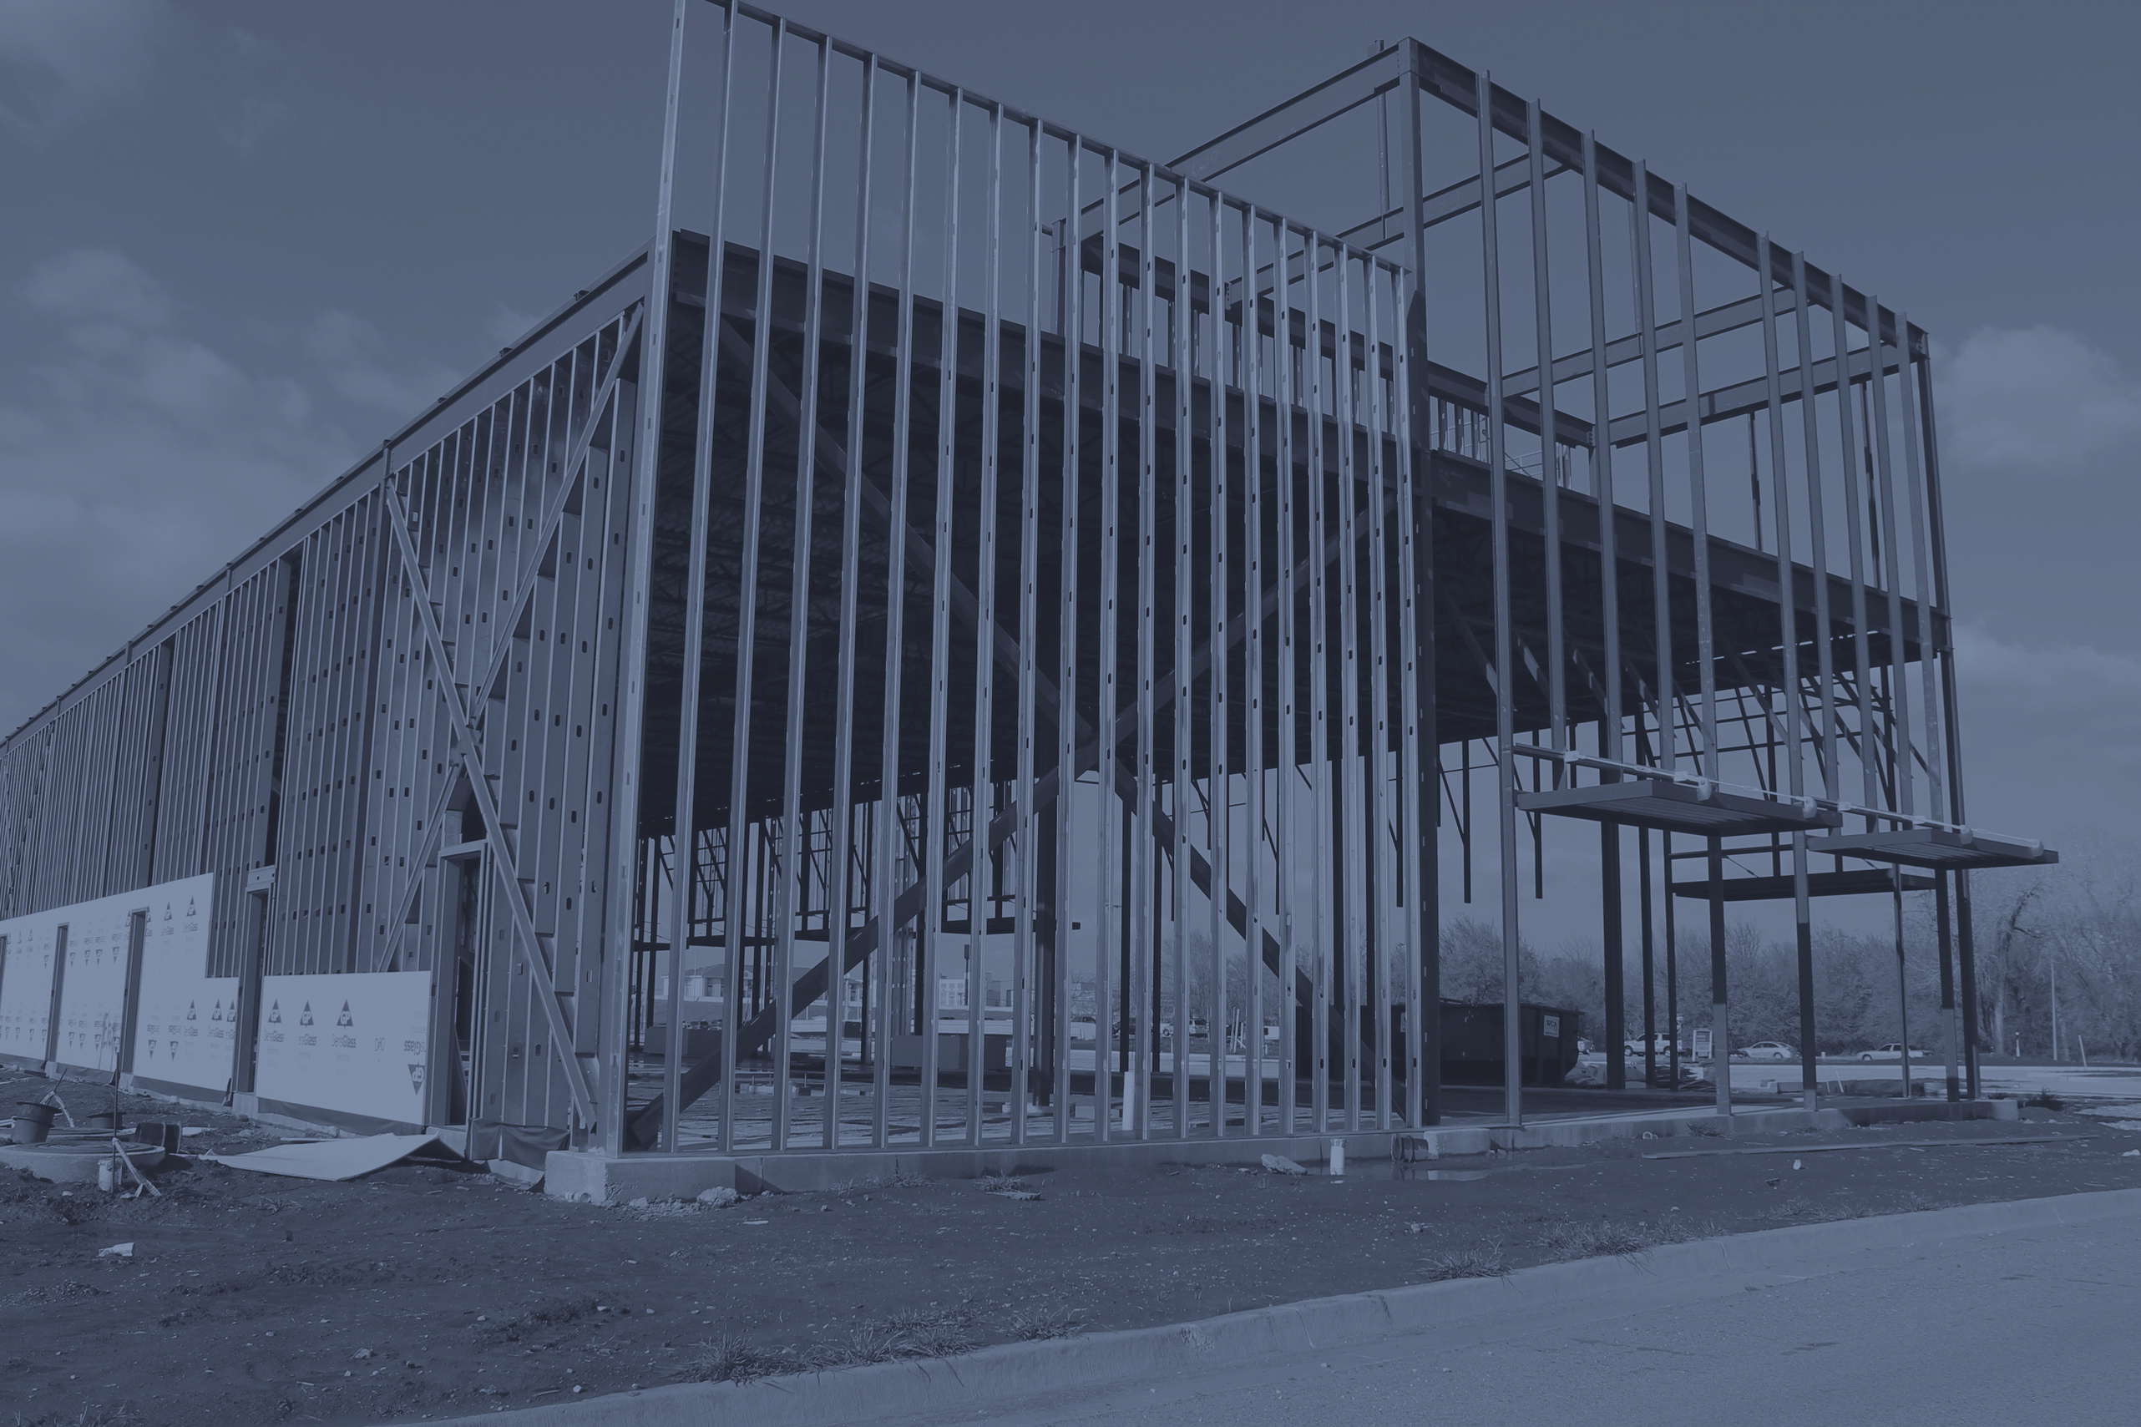


THANK YOU.
GET IN TOUCH WITH US:
info@fortunepmx.com
FORTUNE

